Slide 1

Job Hunting in the
New World
Landing and Launching
Remotely
Amanda Laungani
Associate Director
Career Development Center

Slide 2

The Current Landscape – what we are seeing
Lots of Job Postings
Drawn-out hiring season
Organizations in a holding pattern
Re-offering from last summers opportunities when possible
More competition in the market
The future is still uncertain
Recruiting is happening, offers are being made!

Slide 3

Suggestions for the job search
NETWORK!
Keep an eye on trends
Broaden your search
  Consider different industries
  Temp to perm positions
  Different locations
Recruiting Automation will continue to increase
Remember your job search basics
Notes:
Attend virtual events hosted by companies of interest
Follow companies on Handshake
Reach out to WPI Alumni via LinkedIn at companies of interest
Stay in touch with your network, networking is the most essential component of the job search normally, it’s even more important now
Keep an eye on how many and what types of jobs are being posted
Check out news and industry sites that monitor business and hiring trends
Larger companies are more resistant to the current climate and may be able to hire more than small to midsize companies
Tech, healthcare, fintech, e-commerce, customer service, renewable energy are predicted to be the most pandemic proof industries
Tailor your resume, companies are using and will continue to use scanning software, use language in the job description to tailor your resume
Follow up and human interaction is EVEN more important when a company is recruiting using a lot of automation
Don’t apply to a million places, be intentional, tailor your materials, be strategic,
you will have more success if you spend more time applying to less and then less time applying to more

Slide 4
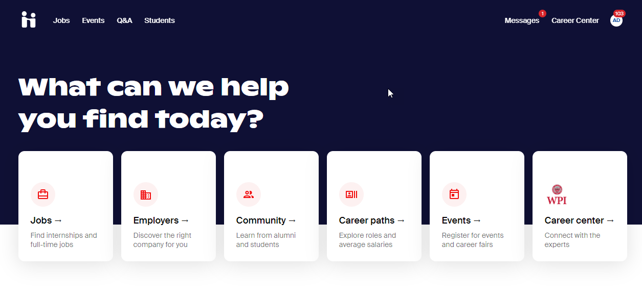
Handshake

Slide 5

Suggestions for the interview process
Recruiting Automation will continue to increase
Most interviews will be virtual, but be sure to clarify in advance
Remember to follow virtual interview protocol
More people on the interview
Know the work environment for the job and speak to it
Ask good questions
Notes:
Companies will continue to use automated or pre-recorded interviews as a first round
The advantage is, it’s easy to prepare you know they are going to ask typical questions like, tell me about yourself, why do you want to work here, why are you a good fir for this position.
Make sure you have a good background that doesn’t wash you out,
You are dressed professionally,
Check video and audio in advance to make sure you can be seen and can be heard,
Look up and into the camera
Remember that if this is a remote work job they will be judging your on camera presence and how that will translate to your day to day in the office
Other things ?
Make sure you address everyone and send everyone a thank you note,
Write down the names of everyone in attendance
If this will be a virtual or remote work position focus on skills like communication and organization which are essential for remote work, also be sure to share how you have done that with you school work over the past year

Slide 6

Additional recommendations
Be creative
Hone your skillset
Make a plan for yourself
Practice self-care
Notes:
– Build a professional website, be active on LinkedIn sharing project work, think about creative ways to use your network
If there is a skill that comes up consistently in jobs you are applying for that you are not familiar with, learn it
Set aside time each week to conduct your job search
Set attainable goals for yourself so you can achieve them
Make sure to take a break and do something that is relaxing to you
Being online on the time for school, social and job searching is exhausting, schedule in non-tech time for youself

Slide 7
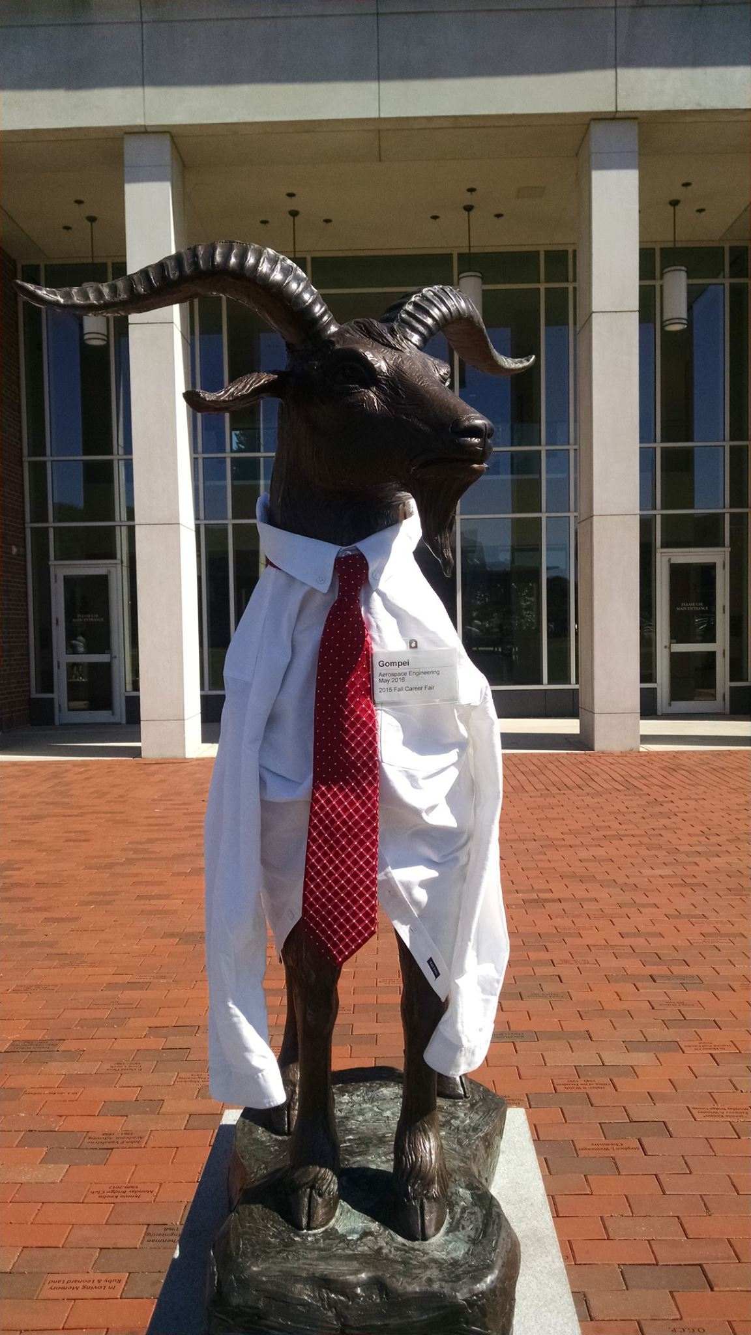
Questions
Amanda Laungani
Email
adlaungani@wpi.edu

